Slide 1
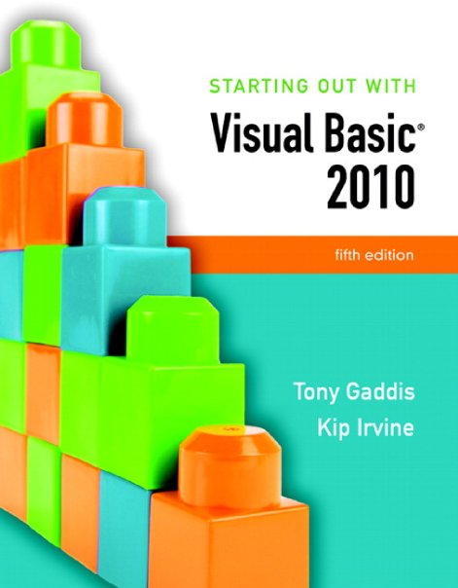

Slide 2
Chapter 4
Making Decisions

Slide 3
Introduction
This chapter covers the Visual Basic decision statements
If…Then
If…Then…Else
If…Then…ElseIf
Select Case
It also discusses the use of
Radio Buttons
Check Boxes
Message Boxes
Input Validation

Slide 4
The Decision Structure
Section 4.1
The decision structure allows a program’s logic to have more than
one path of execution.

Slide 5
Order of Statement Execution
Thus far, our code has been executed sequentially in a sequence structure
To write meaningful programs we need multiple paths of execution
Some statements should be executed under certain circumstances in a decision structure
This chapter presents the means to execute statements conditionally
Next chapter presents the means to execute the same statements repeatedly

Slide 6
The Decision Structure
Flowchart of a typical decision structure
Evaluate the condition
Is it cold outside?
Execute or skip over some code
If yes, wear a coat
Is it cold outside?
True
False
Wear a coat.

Slide 7
The If...Then Statement
Section 4.2
The If...Then statement causes other statements to execute only
when an expression is true.

Slide 8
General Format
If the expression is True, execute the statements between If…Then and End If
Otherwise, the statements are skipped
If expression Then
statement
(more statements may follow)
End If

Slide 9
Relational Operators
Usually a condition is formed using a relational operator
A relational operator determines if a specific relationship exists between two values
> Greater than
< Less than
= Equal to
<> Not equal to
>= Greater than or equal to
<= Less than or equal to

Slide 10
Boolean Expressions
Relational operators are binary – meaning they use two operands, for example:
length > width Is length greater than width?
size <= 10 Is size less than or equal 10?
Relational operators are used in Boolean expressions which yield a true or false result

Slide 11
Putting It All Together
If…Then statement examples:
If decSales > 50000 Then
MessageBox.Show("You've earned a bonus!")
End If
If decSales > 50000 Then
MessageBox.Show("You've earned a bonus!")
decCommissionRate = 0.12
intDaysOff = intDaysOff + 1
End If

Slide 12
Rules to Remember
The If and the Then must be on the same line
Only a remark may follow the Then
The End If must be on a separate line
Only a remark may follow the End If
Tutorial 4-1 presents an application that uses the If…Then statement

Slide 13
Programming Style
The code between the If…Then and the End If is indented
Visual Basic does not require this
It is a convention among programmers to aid in the readability of programs
By default, the Visual Basic editor will automatically do this indentation as you enter your program

Slide 14
Using Relational Operators with Math Operators
Math operators are evaluated before relational operators
intX + intY and intA - intB are evaluated first
Most programmers prefer to use parentheses to clarify the order of operations
If intX + intY > intA - intB Then
lblMessage.Text = "It is true!"
End If
If (intX + intY) > (intA – intB) Then
lblMessage.Text = "It is true!"
End If

Slide 15
Using Function Calls with Relational Operators
Either or both relational operator operands may be function calls
The return value of the function call is compared to the value using the relational operator
If CInt(txtInput.Text) < 100 Then
lblMessage.Text = "It is true!"
End If

Slide 16
Using Boolean Variables as Flags
A flag is a Boolean variable that signals when some condition exists in the program
Since a Boolean variable is either True or False, it can be used as the condition of an If…Then statement
Since a Boolean variable already evaluates to True or False, an = operator is not required
If blnQuotaMet Then
lblMessage.Text = "You have met your sales quota"
End If

Slide 17
The If...Then...Else Statement
Section 4.3
The If...Then...Else statement executes one group of statements
if the Boolean expression is true and another group of statements if
the Boolean expression is false.

Slide 18
General Format
If the expression is True
execute the statements between If…Then and Else
If the expression is False
execute the statements between Else and End If
If expression Then
statement
(more statements may follow)
Else
statement
(more statements may follow)
End If

Slide 19
Flowchart and Pseudocode
dblTemperature
< 40?
False
True
Display Message
Nice weather we’re
having!
Display Message
A little cold, isn’t it?
If temperature < 40 Then
Display the message “A little cold, isn’t it?”
Else
Display the message “Nice weather we’re having!”
End If

Slide 20
Two Mutually Exclusive Choices
The If…Then…Else has two choices
The condition will either be True or False
So either the Then clause or Else clause will be executed
These are two mutually exclusive choices
Tutorial 4-2 contains an example of the If…Then…Else construct

Slide 21
The If...Then...ElseIf Statement
Section 4.4
The If...Then...ElseIf statement is like a chain of
If...Then...Else statements. They perform their tests,
one after the other, until one of them is found to be true.

Slide 22
Multiple Possible Choices
The If…Then…ElseIf statement allows for an entire series of possible choices
In pseudocode:
If it is very cold Then
Wear a coat
Elseif it is chilly
Wear a light jacket
Elseif it is windy
Wear a windbreaker
Elseif it is hot
Wear no jacket

Slide 23
Multiple Possible Choices
Each of the series of conditions in an If…Then…ElseIf is tested in sequence
When a condition is true, the remaining conditions are ignored
The order of the conditions is vital
Wrong order can result in wrong decision - called a logic error
What if it’s chilly and windy?
If windy is tested before chilly, you’d go out with a windbreaker when you need a jacket

Slide 24
General Format
This construction is like a chain of If...Then...Else statements
The Else part of one statement is linked to the If part of another
If expression Then
statement
(more statements may follow)
ElseIf expression Then
statement
(more statements may follow)
(put as many ElseIf statements as necessary)
Else
statement
(more statements may follow)

Slide 25
Flowchart
Very cold?
True
Wear a heavy jacket
False
Chilly?
True
Wear a light jacket
False
Windy?
True
Wear a windbreaker
False
Hot?
True
Wear no jacket
False

Slide 26
Example of ElseIf Usage
Does the order of these conditions matter?
What happens if we reverse the order?
If dblAverage < 60 Then
lblGrade.Text = "F"
ElseIf dblAverage < 70 Then
lblGrade.Text = "D"
ElseIf dblAverage < 80 Then
lblGrade.Text = "C"
ElseIf dblAverage < 90 Then
lblGrade.Text = "B"
ElseIf sngAverage <= 100 Then
lblGrade.Text = "A"
End If

Slide 27
Using Only If…Then Statements
If dblAverage < 60 Then
lblGrade.Text = "F"
End If
If dblAverage < 70 Then
lblGrade.Text = "D"
End If
If dblAverage < 80 Then
lblGrade.Text = "C"
End If
If dblAverage < 90 Then
lblGrade.Text = "B"
End If
If dblAverage <= 100 Then
lblGrade.Text = "A"
End If
Does this code function correctly?
What is assigned to lblGrade for a 65 average? 75?

Slide 28
Using a Trailing Else
A sequence of ElseIf statements may end with a plain Else, called a trailing Else
If none of the conditions are True, the trailing Else statement(s) will be executed
The trailing Else catches any value that falls through the cracks
' Display the letter grade.
If dblAverage < 60 Then
lblGrade.Text = "F"
ElseIf dblAverage < 70 Then
lblGrade.Text = "D"
ElseIf dblAverage < 80 Then
lblGrade.Text = "C"
ElseIf dblAverage < 90 Then
lblGrade.Text = "B"
ElseIf dblAverage <= 100 Then
lblGrade.Text = "A"
Else
lblGrade.Text = "Invalid Score"
End If

Slide 29
Nested If Statements
Section 4.5
A nested If statement is an If statement in the conditionally
executed code of another If statement. (In this section, we use the
term If statement to refer to an If . . . Then, If...Then...Else,
or If...Then...ElseIf statement.)

Slide 30
If Statements Within If Statements
Any type of statement may be used inside a set of Then, Else, or ElseIf statements of an If
This includes other If statements
If statements within If statements create a more complex decision structure called a Nested If

Slide 31
Nested If Example
Tutorial 4-4 examines an application that uses nested If Statements
In the application, the customer must meet one of the following qualifications:
Earn $30,000 per year or more and have worked in his or her current job for more than two years.
Have worked at his or her current job for more than five years.

Slide 32
Examining the Nested If Statement
If dblSalary > 30000 Then
If intYearsOnJob > 2 Then
lblMessage.Text = "Applicant qualifies."
Else
lblMessage.Text = "Applicant does not qualify."
End If
Else
If intYearsOnJob > 5 Then
lblMessage.Text = "Applicant qualifies."
Else
lblMessage.Text = "Applicant does not qualify."
End If
End If

Slide 33
Flowchart of Nested If Statements
Salary > $30,000?
False
True
Years at
current job
> 5?
Years at
current job
> 2?
False
True
False
True
Display message
The applicant does
not qualify.
Display message
The applicant
qualifies.
Display message
The applicant does
not qualify.
Display message
The applicant
qualifies.

Slide 34
Logical Operators
Section 4.6
Logical operators combine two or more Boolean expressions into a
single expression.

Slide 35
Visual Basic Logical Operators
Visual Basic provides Logical operators that can combine multiple Boolean expressions into a compound expression
Operator | Effect
And | Combines two expressions into one. Both expressions must be true for the overall expression to be true.
Or | Combines two expressions into one. One or both expressions must be true for the overall expression to be true. It is only necessary for one to be true, and it does not matter which.
Xor | Combines two expressions into one. One expression (not both) must be true for the overall expression to be true. If both expressions are true, or both expressions are false, the overall expression is false.
Not | Reverses the logical value of an expression: makes a true expression false and a false expression true.

Slide 36
The And Operator
The And operator combines two expressions into one
The following If statement uses the And operator:
Both expressions must be true for the overall expression to be true, as shown in the following truth table:
If intTemperature < 20 And intMinutes > 12 Then
lblMessage.Text = "The temperature is in the danger zone."
End If
Expression 1 | Expression 2 | Expression 1 And Expression 2
True | False | False
False | True | False
False | False | False
True | True | True

Slide 37
Short-Circuit Evaluation with AndAlso
When using the And operator, if the first expression is false, then the entire expression will be false
If there is no need to evaluate the second expression, it can be skipped using a method called short-circuit evaluation
In Visual Basic you use the AndAlso operator to achieve short-circuit evaluation

Slide 38
Short-Circuit Evaluation with AndAlso
In the following example, assuming that dblX is less than or equal to zero, CheckValue is not called and Expression is False is displayed:
If dblX > 0 AndAlso CheckValue(dblX) Then
lblResult.Text = "Expression is True"
Else
lblResult.Text = "Expression is False"
End If

Slide 39
The Or Operator
The Or operator combines two expressions into one
The following If statement uses the Or operator:
One or both expressions must be true for the overall expression to be true, as shown in the following truth table:
If intTemperature < 20 Or intTemperature > 100 Then
lblMessage.Text = "The temperature is in the danger zone."
End If
Expression 1 | Expression 2 | Expression 1 Or Expression 2
True | False | True
False | True | True
False | False | False
True | True | True

Slide 40
Short Circuit-Evaluation with OrElse
When using the Or operator, if the first expression is true, then the entire expression will be true
If there is no need to evaluate the second expression, it can be skipped using short-circuit evaluation with the OrElse operator

Slide 41
Short Circuit-Evaluation with OrElse
In the following example, if dblX is equal to zero, CheckValue is not called and Expression is True is displayed:
If dblX = 0 OrElse CheckValue(dblX) Then
lblResult.Text = "Expression is True"
End If

Slide 42
The Xor Operator
The Xor operator combines two expressions into one
Xor stands for exclusive or
The following If statement uses the Xor operator:
One but not both expressions must be true for the overall expression to be true, as shown in the following truth table:
If decTotal > 1000 Xor decAverage > 120 Then
lblMessage.Text = "You may try again."
End If
Expression 1 | Expression 2 | Expression 1 Xor Expression 2
True | False | True
False | True | True
False | False | False
True | True | False

Slide 43
The Not Operator
The Not operator takes a Boolean expression and reverses its logical value
The following If statement uses the Not operator:
If the expression is true, the Not operator returns False, and if the expression is false, it returns True, as shown in the following truth table:
If Not intTemperature > 100 Then
lblMessage.Text = "You are below the maximum temperature."
End If
Expression | Not Expression
True | False
False | True

Slide 44
Checking Numerical Ranges
The And operator is best for checking if a value is inside a range of numbers
The Or operator is best for checking if a value is outside a range of numbers
If intX >= 20 And intX <= 40 Then
lblMessage.Text = "The value is in the acceptable range."
End If
If intX < 20 Or intX > 40 Then
lblMessage.Text = "The value is outside the acceptable range."
End If

Slide 45
Precedence of Logical Operators
Logical operators have an order of precedence just as arithmetic operators do
From highest to lowest precedence
Not
And
Or
Xor
As with arithmetic operations, parentheses are often used to clarify order of operations

Slide 46
Precedence of Logical Operators
For example, in the statement
If x < 0 And y > 100 Or z = 50
x < 0 And y > 100 is evaluated first
If the And condition is true, we then evaluate
True Or z = 50
If the And condition is false, we then evaluate
False Or z = 50
If the Or condition is to be evaluated first, parentheses must be used
If x < 0 And (y > 100 Or z = 50)

Slide 47
Math, Relational, & Logical Operators
Evaluate the following if: a=5, b=7, x=100, y=30
If x > a * 10 And y < b + 20
Evaluating the math operators leaves us with
If x > 50 And y < 27
Evaluating the relational operators leaves
If True And False
Evaluating the logical operators leaves
False
Parentheses make order of operations clear
If (x > (a * 10)) And (y < (b + 20))

Slide 48
START HERE TONIGHT

Slide 49
Comparing, Testing, and Working with Strings
Section 4.7
Visual Basic provides various methods in the String class that
make it easy to work with strings. This section shows you how to
use relational operators to compare strings, and discusses several
functions and string methods that perform tests and manipulations
on strings.

Slide 50
Strings Can Be Compared
Relational operators can be used to compare strings and string literals
strName1 = "Mary"
strName2 = "Mark"
If strName1 = strName2 Then
lblMessage.Text = " Names are the same"
Else
lblMessage.Text = " Names are NOT the same"
End If
If strMonth <> "October" Then
' statement
End If

Slide 51
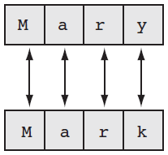
How Are Strings Compared?
Characters are stored as numeric values
Visual Basic uses Unicode
The Unicode numbering system represents:
All letters of the alphabet
Printable digits 0 through 9
Punctuation symbols and special characters
Letters (A,B,C) are arranged alphabetically
The numeric value of A is less than the numeric value of B
Characters of each string are compared one by one until a difference is found
Mary is greater than Mark because "y" has a Unicode value greater than "k"

Slide 52
Testing for No Input
The predefined constant String.Empty represents an empty string, which is a string that contains no characters
Useful for determining whether the user has provided input for a required field before performing operations on that field
If txtInput.Text = String.Empty Then
lblMessage.Text = "Please enter a value"
Else
' The txtInput control contains input, so
' perform an operation with it here.
End If

Slide 53
The ToUpper and ToLower Methods
The ToUpper method can be applied to a string
Results in a string with lowercase letters converted to uppercase
The original string is not changed
General Format:
In the following example, strBigWord is assigned the string "HELLO" using the ToUpper method:
The ToLower method can be applied to a string
Results in a string with uppercase letters converted to lowercase
The original string is not changed
General Format:
In the following example, strLittleTown is assigned the string "new york" using the ToLower method:
StringExpression.ToUpper()
StringExpression.ToLower()
strLittleWord = "Hello"
strBigWord = strLittleWord.ToUpper()
strBigTown = "NEW YORK"
strLittleTown = strBigTown.ToLower()

Slide 54
A Handy Use for ToUpper or ToLower
ToUpper or ToLower can be used to perform case insensitive comparisons of strings
1st comparison below is false "HELLO" <> "hello"
2nd comparison is true
ToLower converts both strings to lower case
Causes "hello" to be compared to "hello"
Tutorial 4-5 demonstrates how this is used
strWord1 = "HELLO"
strWord2 = "hello"
If strWord1 = strWord2 ' False, not equal
If strWord1.ToLower() = strWord2.ToLower() ' True, equal

Slide 55
The IsNumeric Function
This function accepts a string as an argument and returns True if the string contains a number
Use IsNumeric function to determine if a given string contains numeric data
Dim strNumber As String
strNumber = "576"
If IsNumeric(strNumber) ' Returns true
strNumber = "123abc"
If IsNumeric(strNumber) ' Returns false

Slide 56
Determining the Length of a String
The Length property, a member of the String class, returns the number of characters in a string
In the following example, the intNumChars variable contains the value 6:
You can also determine the length of a control’s Text property, as shown in the following code:
Dim strName As String = "Herman"
Dim intNumChars As Integer
intNumChars = strName.Length
If txtInput.Text.Length > 20 Then
lblMessage.Text = "Please enter no more than 20 characters."
End If

Slide 57
Trimming Spaces from Strings
There are three methods that remove spaces from strings:
TrimStart : removes leading spaces
TrimEnd : removes trailing spaces
Trim : removes leading and trailing spaces
Here is the general format for each method:
An example with three leading and trailing spaces, using each method:
StringExpression.TrimStart()
StringExpression.TrimEnd()
StringExpression.Trim()
strGreeting = " Hello "
lblMessage1.Text = strGreeting.TrimStart() ' lblMessage1.Text = "Hello "
lblMessage2.Text = strGreeting.TrimEnd() ' lblMessage2.Text = " Hello"
lblMessage3.Text = strGreeting.Trim() ' lblMessage3.Text = "Hello"

Slide 58
The Substring Method
The Substring method returns a portion of a string or a “string within a string” (a substring)
Each character position is numbered sequentially with the 1st character referred to as position zero
StringExpression.Substring(Start)
Returns the characters from the Start position to the end of the string
StringExpression.Substring(Start, Length)
Returns the number of characters specified by Length beginning with the Start position

Slide 59
Substring Method Examples
The first example starts at the 8th (W) character in the string and continues to the end of the string:
The second example starts at the beginning (G) of the string and continues until it reaches the 7th (empty space) character of the string:
Dim strLastName As String
Dim strFullName As String = "George Washington"
strLastName = strFullName.Substring(7) ' Washington
Dim strFirstName As String
Dim strFullName As String = "George Washington"
strFirstName = strFullName.Substring(0, 6) ' George

Slide 60
The IndexOf Method
The IndexOf method searches for a character or string within a string, it has three general formats:
StringExpression.IndexOf(Searchstring)
Searches the entire string for SearchString
StringExpression.IndexOf(SearchString, Start)
Starts at the character position Start and searches for SearchString from that point
StringExpr.IndexOf(SearchString, Start, Count)
Starts at the character position Start and searches Count characters for SearchString

Slide 61
IndexOf Method Examples
The IndexOf method will return the starting position of the SearchString in the string being searched
Positions are numbered from 0 (for the first)
If SearchString is not found, a value of -1 is returned
Tutorial 4-6 provides an opportunity to work with several of the string methods
Position 0
Position 9
Dim name As String = "Angelina Adams"
Dim position As Integer
position = name.IndexOf("A", 1)
' position has the value 9

Slide 62
More about Message Boxes
Section 4.8
Sometimes you need a convenient way to display a message to the
user. This section discusses the MessageBox.Show method, which
allows you to display a message in a dialog box.

Slide 63
Message Box Arguments
A message box is a dialog box with a user message in a pop-up window
The following can be specified
Message - text to display within the box
Caption - title for the top bar of the box
Buttons - indicates which buttons to display
Icon - indicates icon to display
DefaultButton - indicates which button corresponds to the Return Key
Message is required, the remaining arguments are optional
Use of an argument requires those before it
MessageBox.Show(Message, Caption, Buttons, Icon, DefaultButton)

Slide 64
The Optional Buttons Argument
Unless specified, the message box has only an OK button
Buttons is a value that specifies which buttons to display in the message box
MessageBox.Show(Message, Caption, Buttons, Icon, DefaultButton)
Value | Description
MessageBoxButtons.AbortRetryIgnore | Displays Abort, Retry, and Ignore buttons
MessageBoxButtons.OK | Displays only an OK button
MessageBoxButtons.OKCancel | Displays OK and Cancel buttons
MessageBoxButtons.RetryCancel | Displays Retry and Cancel buttons
MessageBoxButtons.YesNo | Displays Yes and No buttons
MessageBoxButtons.YesNoCancel | Displays Yes, No, and Cancel buttons

Slide 65

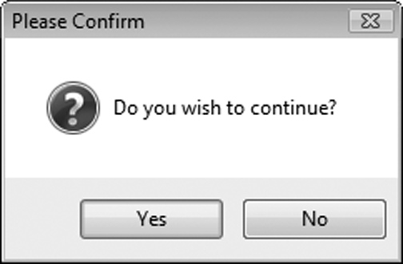

The Optional Icon Argument
Icon is a value that specifies an icon to display in the message box
For example:
MessageBox.Show(Message, Caption, Buttons, Icon, DefaultButton)
Value | Image
MessageBoxIcon.Asterisk MessageBoxIcon.Information
MessageBoxIcon.Error MessageBoxIcon.Hand MessageBoxIcon.Stop
MessageBoxIcon.Exclamation MessageBoxIcon.Warning
MessageBoxIcon.Question
MessageBox.Show("Do you wish to continue?", "Please Confirm",
MessageBoxButtons.YesNo, MessageBoxIcon.Question)

Slide 66
The Optional DefaultButton Argument
The DefaultButton argument specifies which button to select as the default button
The default button is the button clicked when the user presses the Enter key
MessageBox.Show(Message, Caption, Buttons, Icon, DefaultButton)
Value | Description
MessageBoxDefaultButton.Button1 | Selects the leftmost button on the message box as the default button
MessageBoxDefaultButton.Button2 | Selects the second button from the left edge of the message box as the default button
MessageBoxDefaultButton.Button3 | Selects the third button from the left edge of the message box as the default button

Slide 67
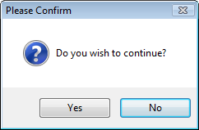
MessageBox Example
The following statement displays a message box and selects Button2 (the No button) as the default button:
MessageBox.Show( "Do you wish to continue?",
"Please Confirm",
MessageBoxButtons.YesNo,
MessageBoxIcon.Question,
MessageBoxDefaultButton.Button2 )

Slide 68
Determining Which Button the User Clicked
The MessageBox.Show method returns an integer that indicates which button the user clicked
Value | Meaning
Windows.Forms.DialogResult.Abort | The user clicked the Abort button
Windows.Forms.DialogResult.Cancel | The user clicked the Cancel button
Windows.Forms.DialogResult.Ignore | The user clicked the Ignore button
Windows.Forms.DialogResult.No | The user clicked the No button
Windows.Forms.DialogResult.OK | The user clicked the OK button
Windows.Forms.DialogResult.Retry | The user clicked the Retry button
Windows.Forms.DialogResult.Yes | The user clicked the Yes button

Slide 69
Determining Which Button the User Clicked Example Code
The following code shows how an If statement can take actions based on which message box button the user clicked:
Dim intResult As Integer
intResult = MessageBox.Show("Do you wish to continue?",
"Please Confirm",
MessageBoxButtons.YesNo)
If intResult = Windows.Forms.DialogResult.Yes Then
' Perform an action here
ElseIf intResult = Windows.Forms.DialogResult.No Then
' Perform another action here
End If

Slide 70
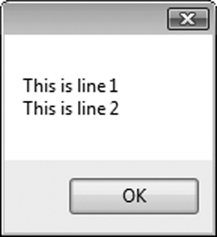
Using ControlChars.CrLf to Display Multiple Lines
If you want to display multiple lines of information in a message box, use the constant ControlChars.CrLf
CrLf stands for Carriage return Line feed
Concatenate(&) it with the string you wish to display, where you wish to begin a new line
MessageBox.Show("This is line 1"
& ControlChars.CrLf &
"This is line 2")

Slide 71
The Select Case Statement
Section 4.9
In a Select Case statement, one of several possible actions is
taken, depending on the value of an expression.

Slide 72
The Select Case Statement
Similar to If…Then…ElseIf
Performs a series of tests
Conditionally executes the first true condition
Select Case is different in that:
A single test expression may be evaluated
The test expression is listed once
The possible values of the expression are then listed with their conditional statements
Case Else may be included and executed if none of the values match the expression

Slide 73
Select Case General Format
Select Case TestExpression
[Case ExpressionList
[one or more statements]]
[Case ExpressionList
[one or more statements]]
' Case statements may be repeated
' as many times as necessary.
[Case Else
[one or more statements]]
End Select

Slide 74
Select Case Statement Example
Select Case CInt(txtInput.Text)
Case 1
MessageBox.Show("Day 1 is Monday.")
Case 2
MessageBox.Show("Day 2 is Tuesday.")
Case 3
MessageBox.Show("Day 3 is Wednesday.")
Case 4
MessageBox.Show("Day 4 is Thursday.")
Case 5
MessageBox.Show("Day 5 is Friday.")
Case 6
MessageBox.Show("Day 6 is Saturday.")
Case 7
MessageBox.Show("Day 7 is Sunday.")
Case Else
MessageBox.Show("That value is invalid.")
End Select

Slide 75
Select Case Flowchart Example
Test Expression
Value 1
Value 2
Value 3
Default
Operation 1
Operation 2
Operation 3
Operation 4

Slide 76
Select Case Pseudocode Example
Select Case Input
Case 1
Display Message “Day 1 is Monday.”
Case 2
Display Message “Day 2 is Tuesday.”
Case 3
Display Message “Day 3 is Wednesday.”
Case 4
Display Message “Day 4 is Thursday.”
Case 5
Display Message “Day 5 is Friday.”
Case 6
Display Message “Day 6 is Saturday.”
Case 7
Display Message “Day 7 is Sunday.”
Case Else
Display Message “That value is invalid.”
End Select

Slide 77
More about the Expression List: Multiple Expressions
The Case statement’s expression list can contain multiple expressions, separated by commas
Select Case intNumber
Case 1, 3, 5, 7, 9
strStatus = "Odd"
Case 2, 4, 6, 8, 10
strStatus = "Even"
Case Else
strStatus = "Out of Range"
End Select

Slide 78
More about the Expression List: String Values
The Case statement can test string values
Select Case strAnimal
Case "Dogs", "Cats"
MessageBox.Show("House Pets")
Case "Cows", "Pigs", "Goats"
MessageBox.Show("Farm Animals")
Case "Lions", "Tigers", "Bears"
MessageBox.Show("Oh My!")
End Select

Slide 79
More about the Expression List: Relational Operators
You can use relational operators in the Case statement
The Is keyword represents the test expression in the relational comparison
Select Case dblTemperature
Case Is <= 75
blnTooCold = True
Case Is >= 100
blnTooHot = True
Case Else
blnJustRight = True
End Select

Slide 80
More about the Expression List: Ranges of Values
You can determine whether the test expression falls within a range of values
Requires the To keyword
Smaller number on the left
Larger number on the right
Numbers on each side are included in the range
Select Case intScore
Case Is >= 90
strGrade = "A"
Case 80 To 89
strGrade = "B"
Case 70 To 79
strGrade = "C"
Case 60 To 69
strGrade = "D"
Case 0 To 59
strGrade = "F"
Case Else
MessageBox.Show("Invalid Score")
End Select

Slide 81
Introduction to Input Validation
Section 4.10
Input validation is the process of inspecting input values and
determining whether they are valid.

Slide 82
Validation Example
Output is only as good as the input
“Garbage in, garbage out”
Input validation is the process of inspecting user input to see that it meets certain rules
The TryParse method verifies that an input value is in a valid numeric or date format
Decision structures are often used to validate input

Slide 83
The TryParse Method
Converts an input value to another format
Verifies that input of integers, decimals, dates, etc., are entered in an acceptable format
Returns Boolean value indicating True if conversion successful
Returns False if unsuccessful
Each numeric variable type has a TryParse method
Date & Boolean types include the TryParse method as well

Slide 84
Verify Integer Entry With TryParse
Use Integer.TryParse method to convert value
txtInput.Text contains numeric string to convert
intResult receives converted value
TryParse returns True if input is an integer
TryParse returns False if input is not an integer
Dim intResult As Integer
If Integer.TryParse(txtInput.Text, intResult) Then
lblMessage.Text = "Success!"
Else
lblMessage.Text = "Error: an integer was not found"
End If

Slide 85
Checking Numeric Ranges
Sometimes you need to check numeric input values to make sure they fall within a range
If intHours >= 0 And intHours <= 168 Then
decGrosspay = intHours * decPayRate
Else
MessageBox.Show("Invalid number of hours.")
End If
If intSpeed < 35 Or intSpeed > 60 Then
MessageBox.Show("Speed violation!")
End If

Slide 86
Focus on GUI Design: Radio Buttons and Check Boxes
Section 4.11
Radio buttons appear in groups of two or more, allowing the
user to select one of several options. A check box allows the user
to select an item by checking a box, or deselect the item by
unchecking the box.

Slide 87
Radio Buttons
Used when only one of several possible options may be selected at one time
Car radio buttons select one station at a time
May be placed in a group box
Group box defines a set of radio buttons
Can select only one button within a group box
Those on a form but not inside a group box are considered members of the same group
Radio buttons have a Boolean Checked property and a CheckChanged event

Slide 88
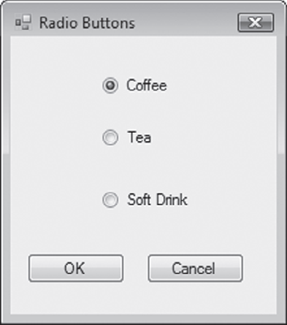
Checking Radio Buttons in Code
If radCoffee.Checked = True Then
MessageBox.Show("You selected Coffee")
ElseIf radTea.Checked = True Then
MessageBox.Show("You selected Tea")
ElseIf radSoftDrink.Checked = True Then
MessageBox.Show("You selected a Soft Drink")
End If

Slide 89
Check Boxes
Unlike radio buttons, can select many check boxes at one time
May also be placed in a group box
Not limited to one selection within a group box
Can select as many check boxes as you like within the same group box
Check boxes also have a Boolean Checked property and a CheckChanged event
Tutorial 4-9 provides radio button and check box examples

Slide 90
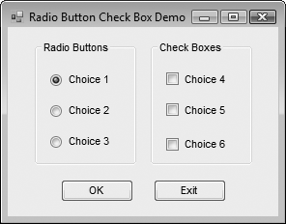
Checking Check Boxes in Code
' Determine which check boxes are checked.
If chkChoice4.Checked = True Then
MessageBox.Show("You selected Choice 4.")
End If
If chkChoice5.Checked = True Then
MessageBox.Show("You selected Choice 5.")
End If
If chkChoice6.Checked = True Then
MessageBox.Show("You selected Choice 6.")

Slide 91
Focus on Program Design and Problem Solving: Building the Health Club Membership Fee Calculator Application
Section 4.12
In this section you build the Health Club Membership Fee
Calculator application. It will use features discussed in this chapter,
including decision structures, radio buttons, and check boxes.

Slide 92
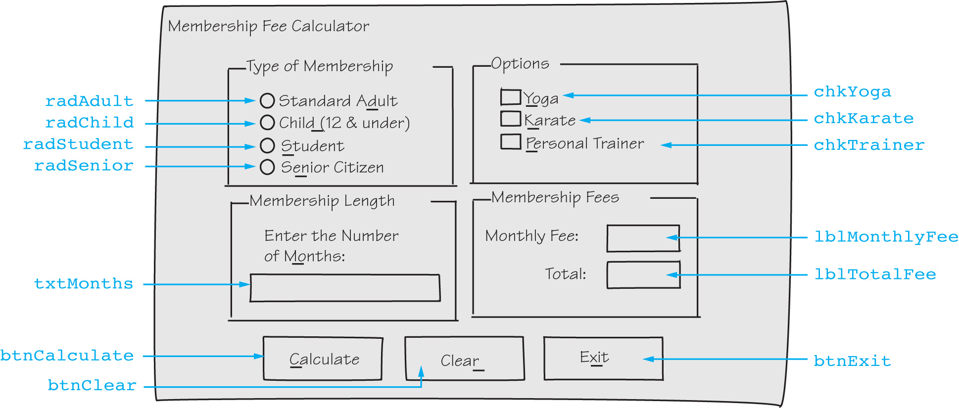
Health Club Fee Calculator Form

Slide 93
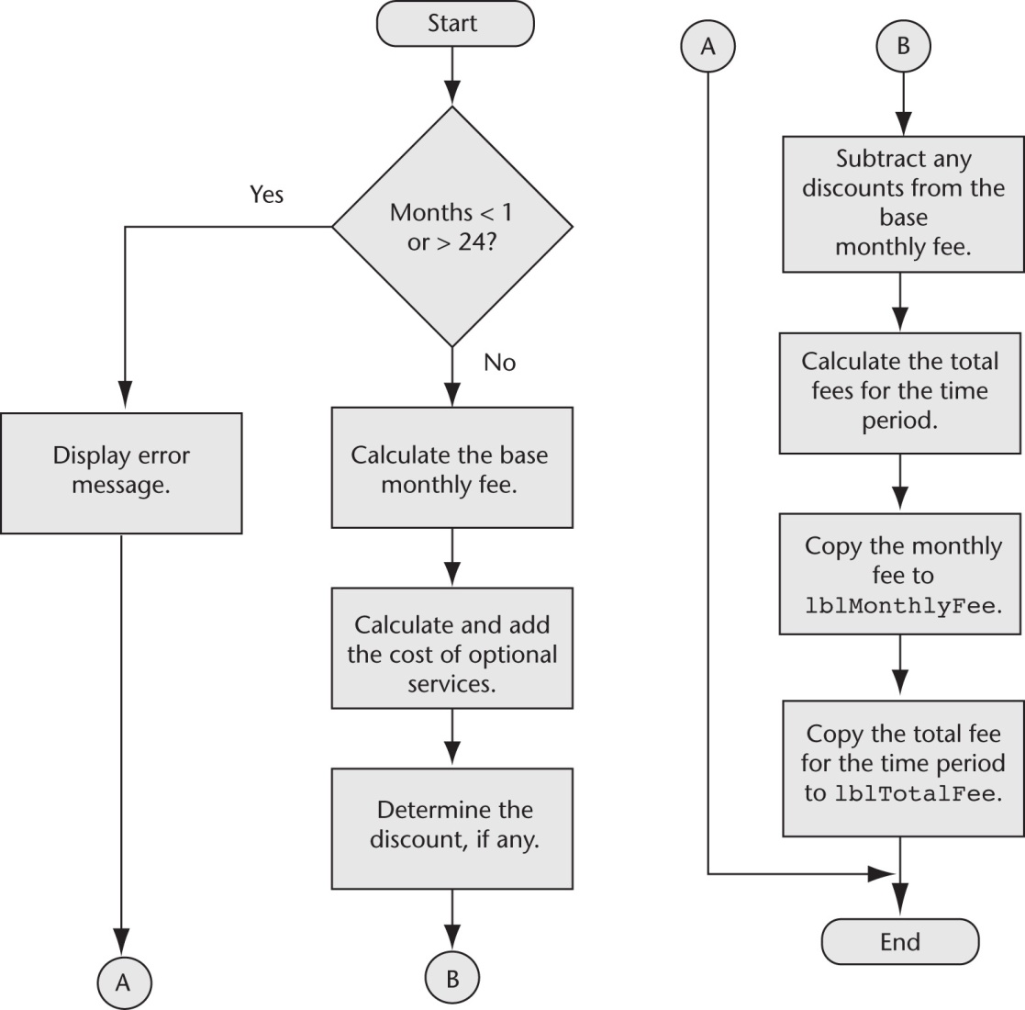
Calculate Button Click Event Flowchart

Slide 94
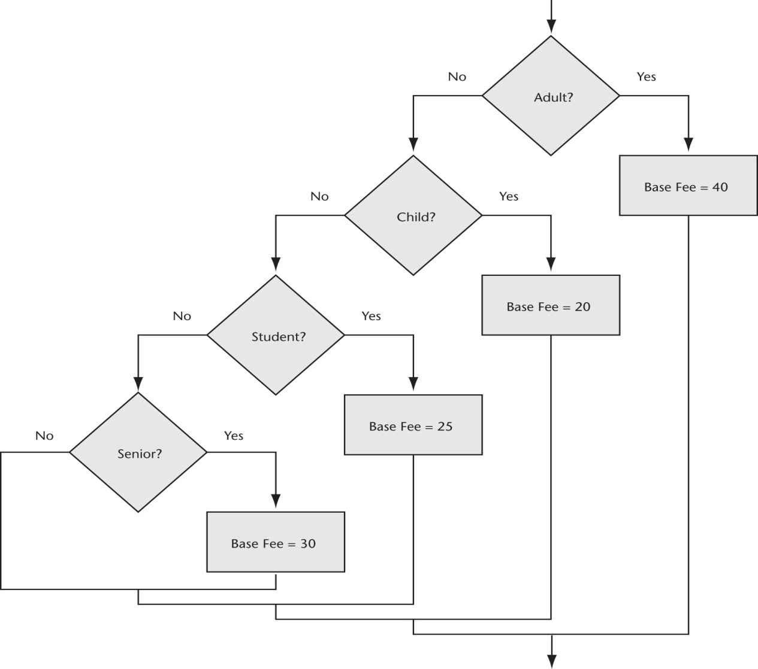
Base Monthly Fee Calculation Flowchart & Pseudocode
If Member is an Adult Then
Monthly Base Fee = 40
ElseIf Member is a Child Then
Montlhy Base Fee = 20
ElseIf Member is a Student Then
Monthly Base Fee = 25
ElseIf Member is a Senior Citizen Then
Monthly Base Fee = 30
End If

Slide 95
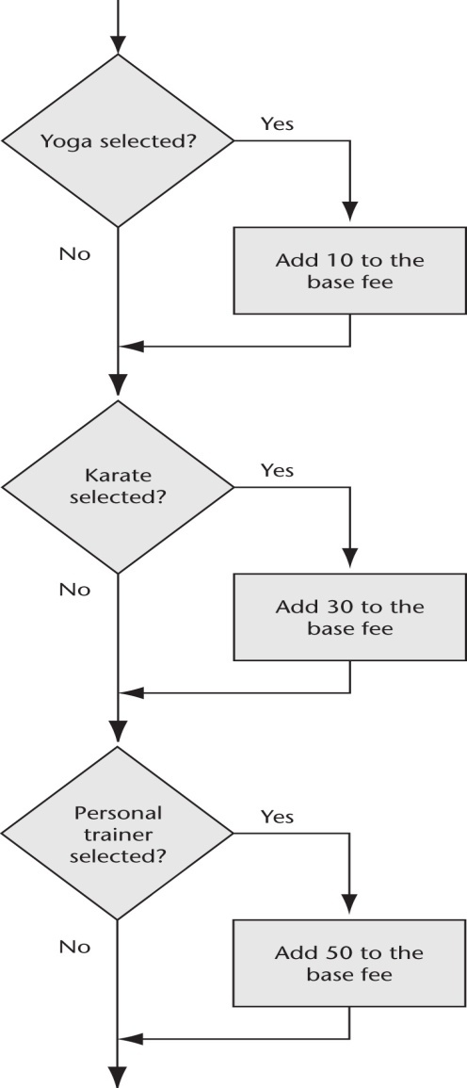
Calculate Optional Services Flowchart & Pseudocode
If Yoga is selected Then
Add 10 to the monthly base fee
End If
If Karate is selected Then
Add 30 to the monthly base fee
End If
If Personal Trainer is selected Then
Add 50 to the monthly base fee
End If

Slide 96
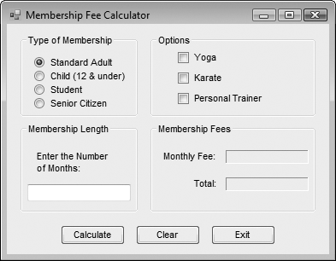
The Completed Membership Fee Calculator Form

Slide 97
Test Data for the Membership Fee Calculator
Type of Membership | Monthly Fee | Total
Standard adult with yoga, karate, and personal trainer for 6 months | $130.00 | $780.00
Child with karate for 3 months | $50.00 | $150.00
Student with yoga for 12 months | $35.00 | $420.00
Senior citizen with karate and personal trainer for 8 months | $110.00 | $880.00

